Slide 1
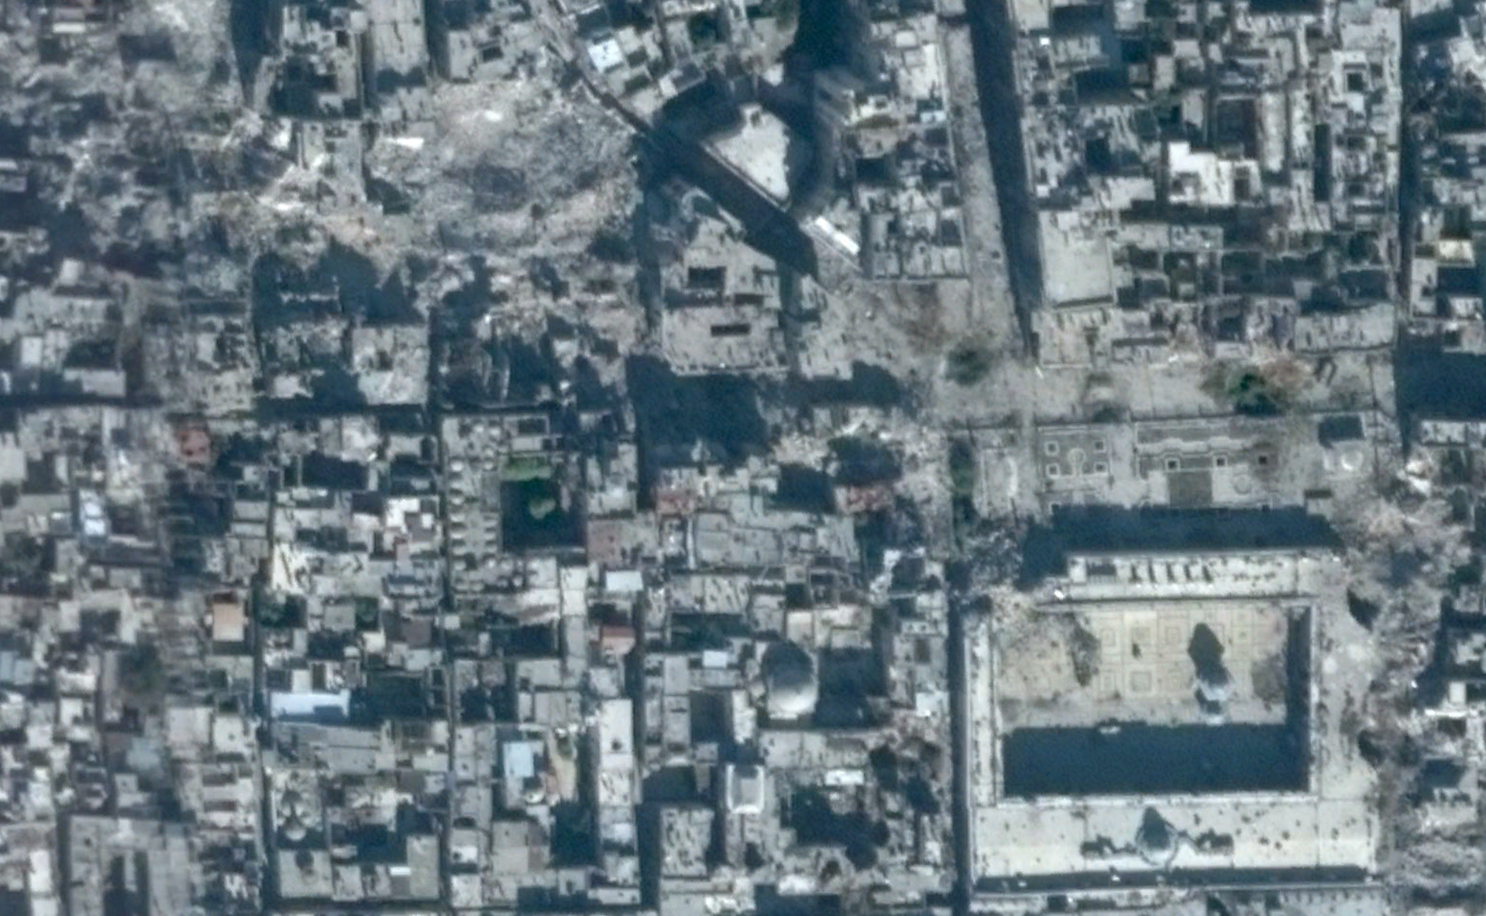
Introduction to Machine Learning for Public Policy
Jonathan Hersh, PhD (Chapman Argyros School of Business)
12/2/2020

Slide 2
Outline
What is Machine Learning?
Machine learning versus econometrics
Why Machine Learning for Public Policy
Big data requires it
Non-linear relationships
Better forecasts/econometrics
Anomaly detection
Some Basic Machine Learning Concepts
Supervised vs Unsupervised learning
Testing/Training Sets
Bias-Variance Tradeoff

Slide 3
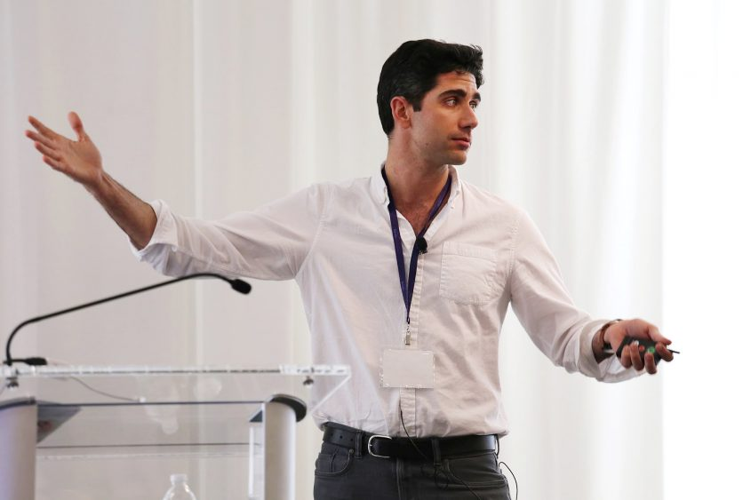
About Me
Assistant Professor Economics and Management Science Chapman University
PhD in economics, Boston University
Research Fields:
Applications of artificial intelligence (computer vision)
Economics of information systems
Development economics
Digitization strategy
Teaching Fields:
Machine learning
Applications of artificial intelligence

Slide 4
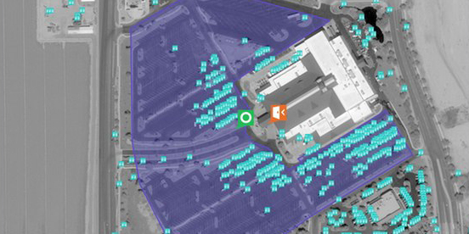
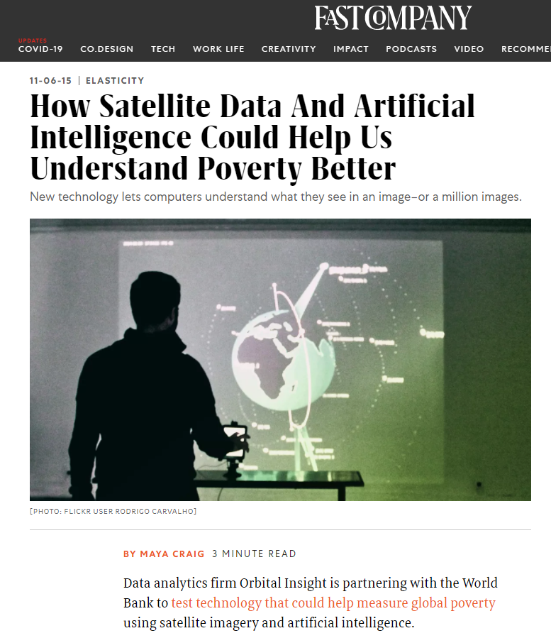

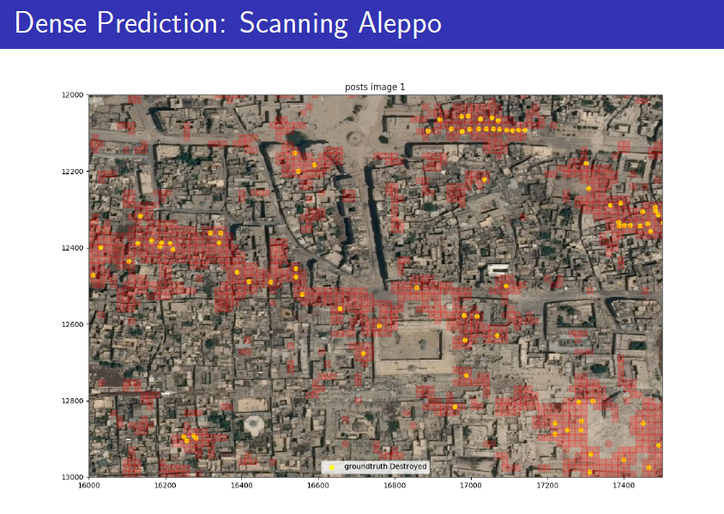
My Research
Satellite Imagery + Computer Vision + Machine Learning
Advised World Bank/IDB on COVID poverty transfers in Belize, Togo, Guinea
Count cars in parking lots!
Damaged buildings in Syria!

Slide 5
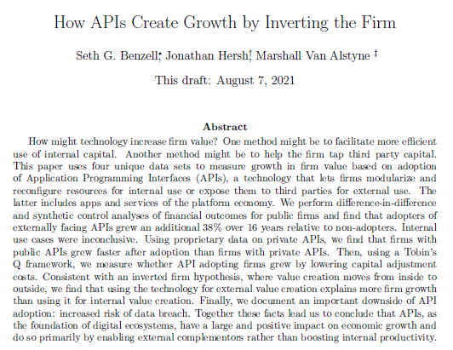
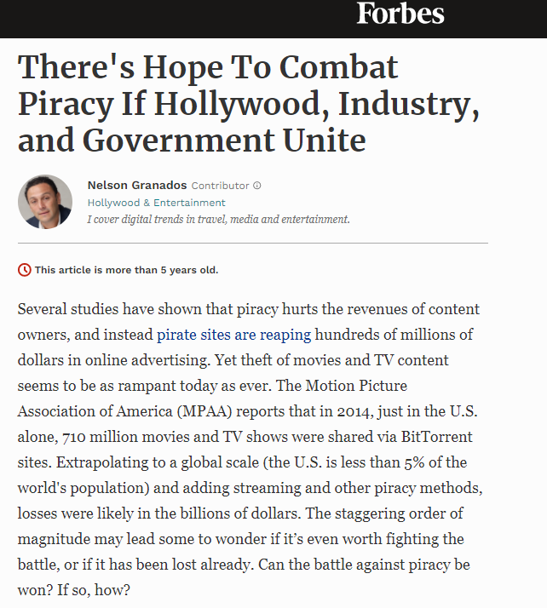
More “Business” Research
Online Media Piracy
IT Strategy

Slide 6
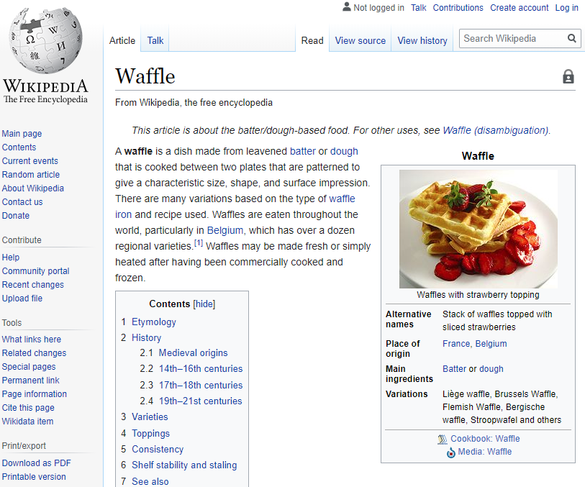
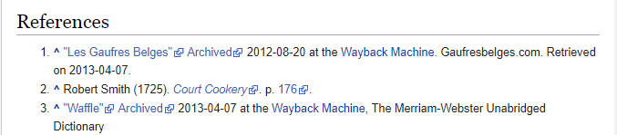
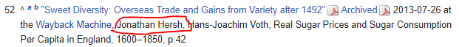
Most Proud of: Cited on the Wikipedia Page for “Waffle”

Slide 7

What is Machine Learning?

Slide 8
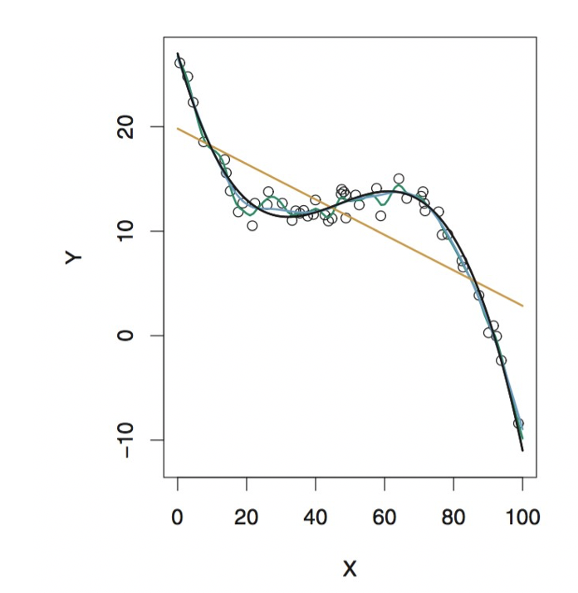
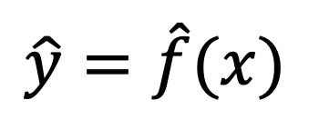
Public Conception of Machine Learning
Reality (90% of the time)
Target or Output
Input data
$\hat{y}=\hat{f}(x)$

Slide 9
Machine Learning Versus Econometrics
Machine Learning
Developed to solve problems in computer science
Prediction/classification
Desire: goodness of fit
Huge Datasets! (Terabytes) Thousands of variables!
Whatever works
Econometrics
Developed to solve problems in economics
Explicitly testing a theory
“Statistical significance” more important than model fit
Small datasets Few dozen variables
“It works in practice, but what about theory?”

Slide 10
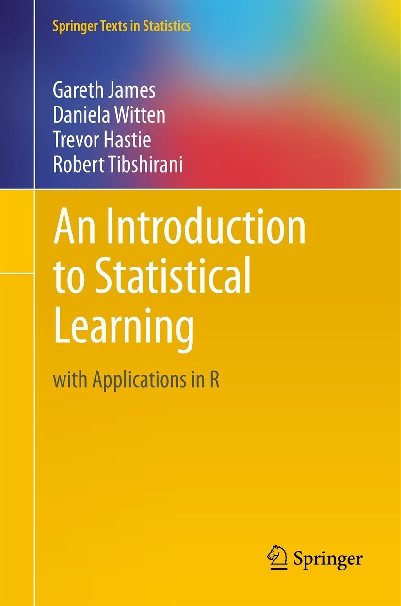

Today – Brief Introduction to Machine Learning
Cross-Validation [Chapter 2 ISLR]
Ridge Regression [Chapter 6 ISLR]
Lasso Regression [Chapter 6 ISLR]
Decision Trees [Chapter 8 ISLR]
Introduction to R [R for Everyone]

Slide 11

Machine Learning Versus Artificial Intelligence

Slide 12
Why Machine Learning?

Slide 13
Arguments for Using Machine Learning for Public Policy
Needed ML Big Data (models with 100+ variables)
“Unstructured” data e.g. satellite imagery, text
Can learn non-linear relationships
Better forecasts / econometrics
Anomaly detection (for fraud detection)

Slide 14
What is Big Data?
Big data is Data with Three “v’s”
High volume
High variety
High velocity

Slide 15
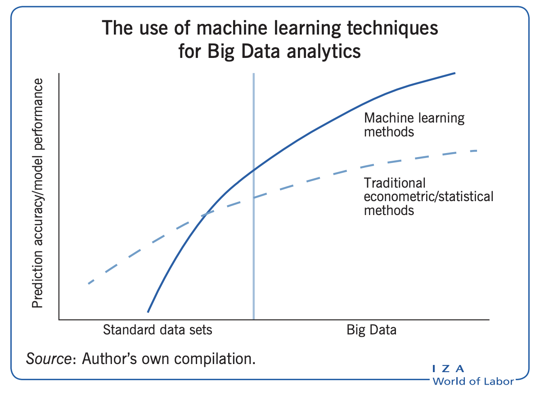
Why ML? (Big Data Needs Machine Learning)
Machine Learning models continue to improve given more data (both # of variables and # of observations)
Bigger datasets: bigger gain from machine learning vs econometrics

Slide 16
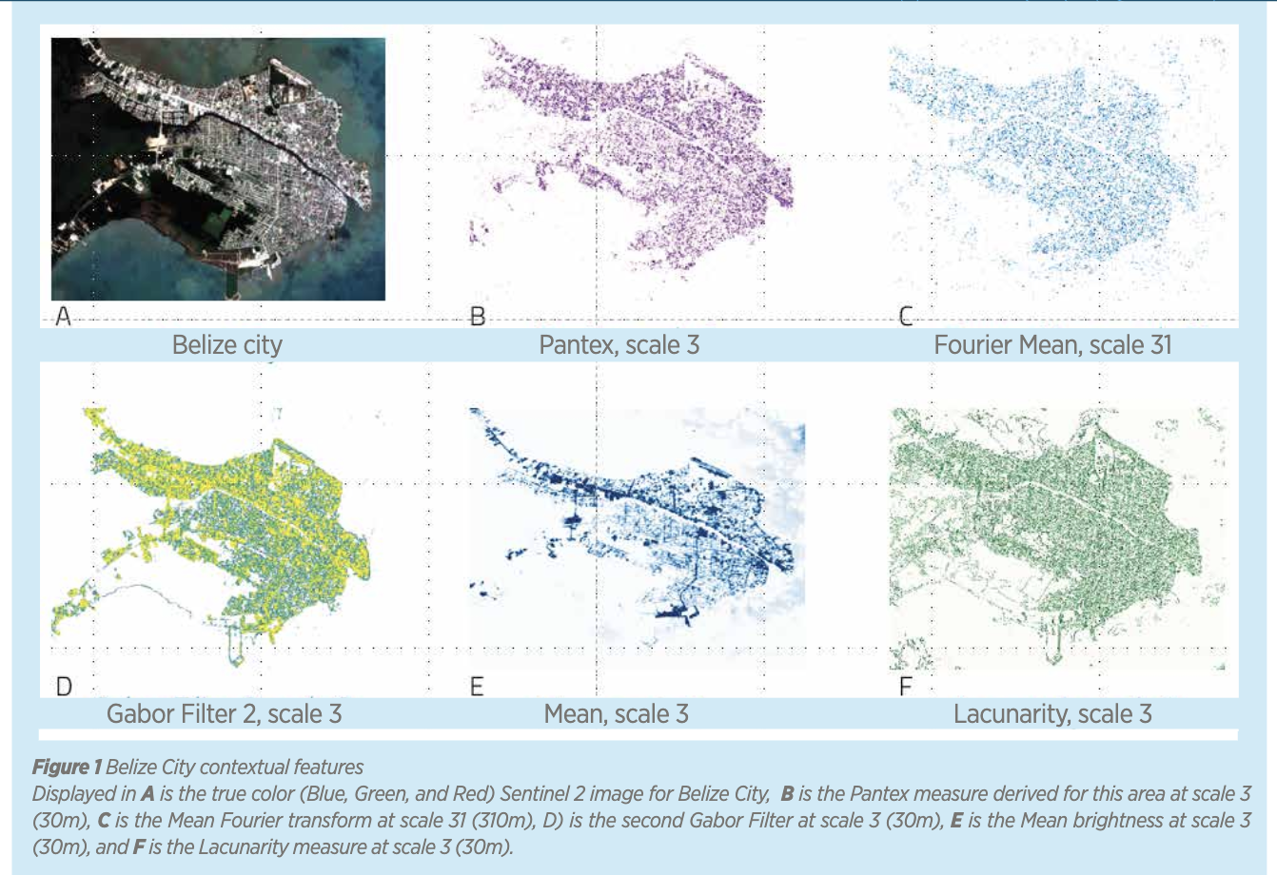
Why ML? (To Use Satellite Imagery ”Big Data”)
Satellite Imagery variables too high dimensional for traditional econometric models
Mapping Poverty in Belize Using Satellite Imagery https://publications.iadb.org/publications/english/document/Mapping-Income-Poverty-in-Belize-Using-Satellite-Features-and-Machine-Learning.pdf

Slide 17
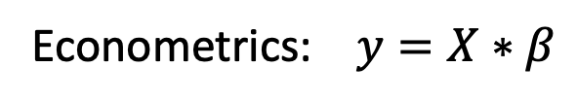
Why ML? (Can learn Nonlinear relationships)
Example: classify “O”s separate from X’s
Y
Econometrics: $y=X∗β$
Machine Learning: regression tree
Model | Accuracy
Econometrics | 80%
Machine Learning | 100%
X

Slide 18
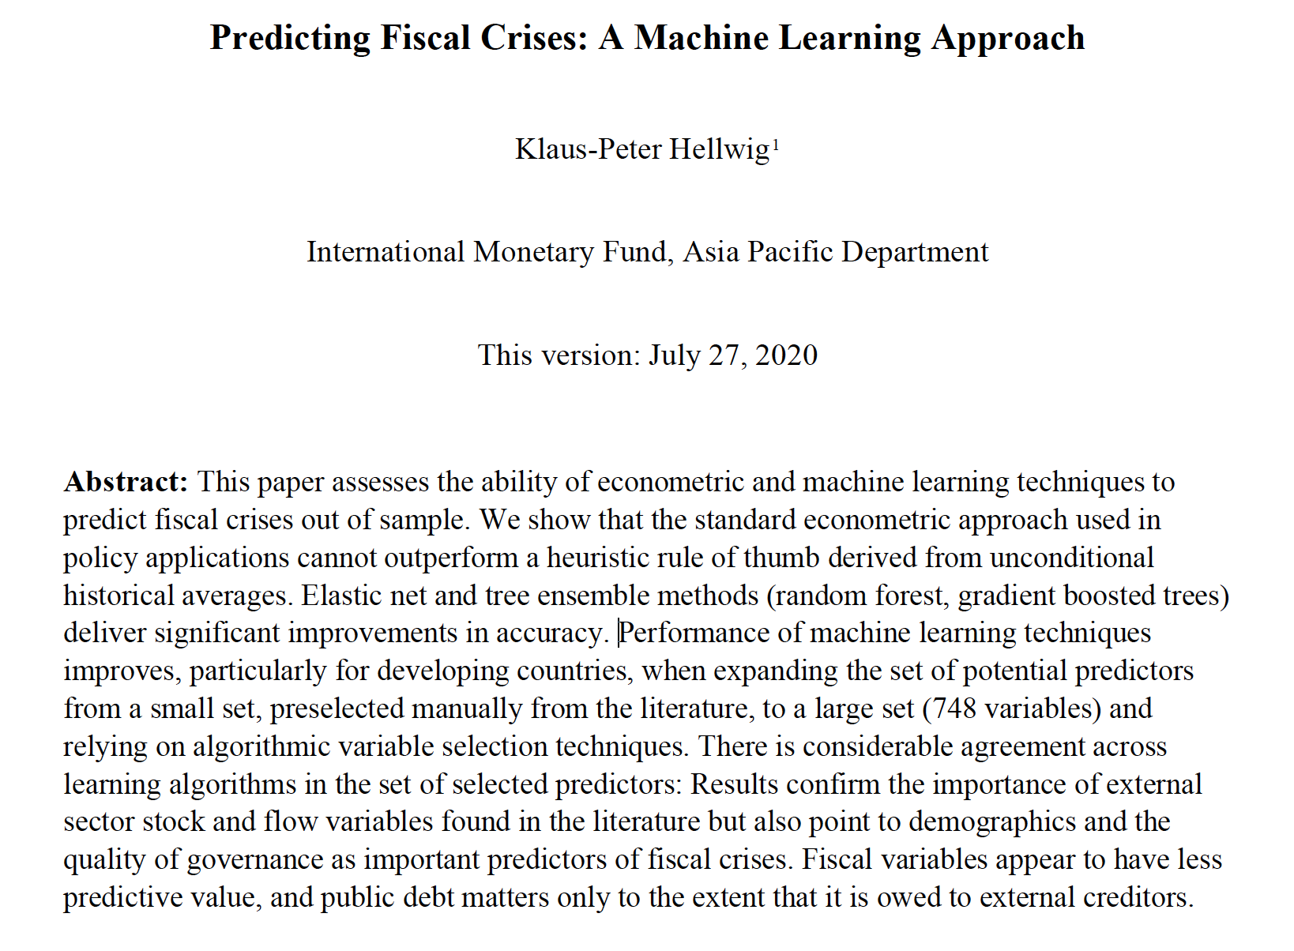
Why ML? (Better Forecasts For Fiscal Crises)

Slide 19
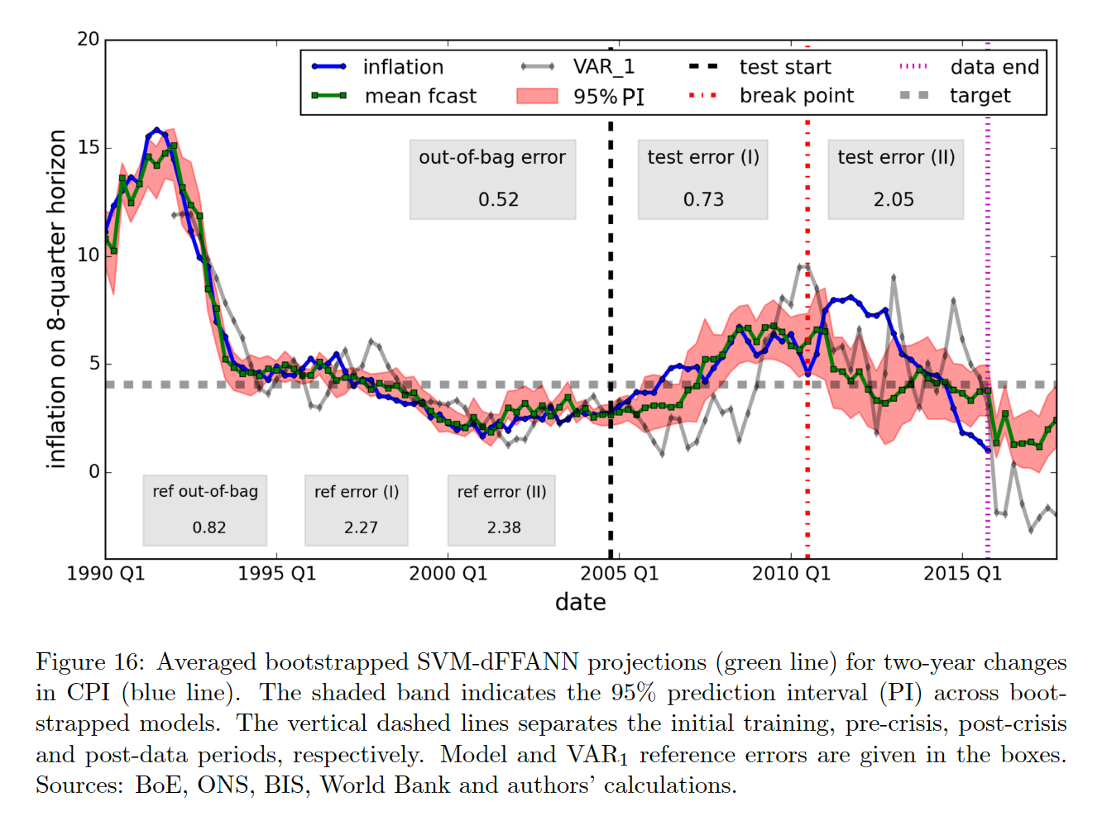
Why ML? (Better Forecasts of Inflation)

Slide 20
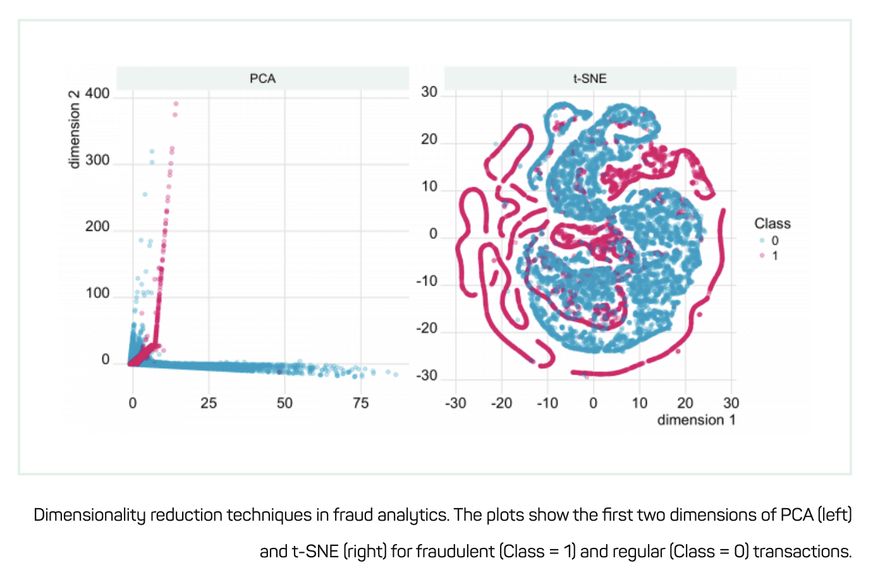
Why ML? (Anomaly Detection Aka Fraud Alerts)
Source: https://shiring.github.io/machine_learning/2017/05/01/fraud

Slide 21
Some Basic Machine Learning Concepts

Slide 22
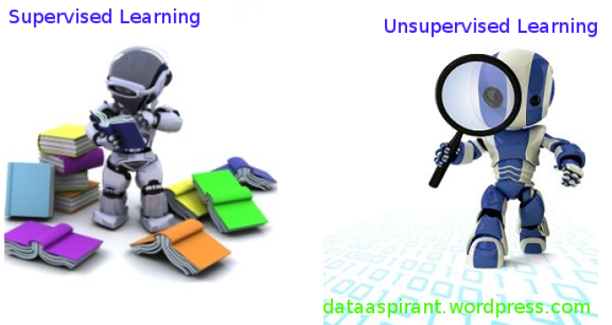
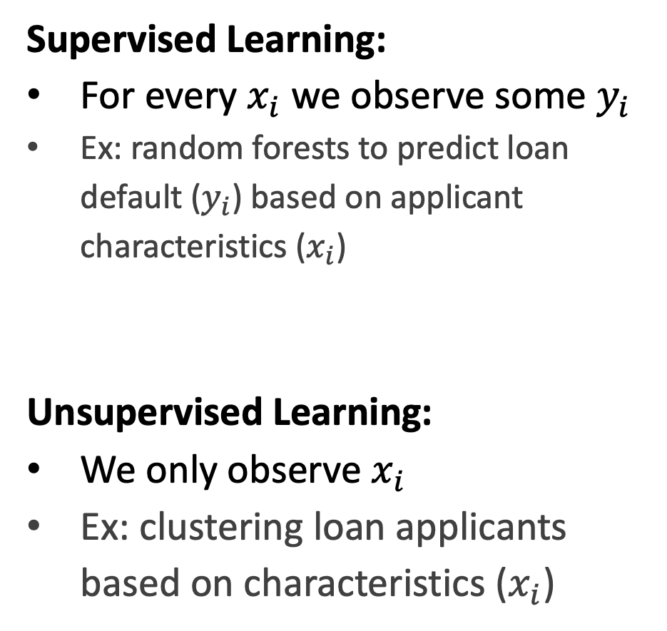
Supervised vs Unsupervised Learning
Supervised Learning:
For every $x_{i}$we observe some $y_{i}$
Ex: random forests to predict loan default ($y_{i}$) based on applicant characteristics ($x_{i}$)
Unsupervised Learning:
We only observe $x_{i}$
Ex: clustering loan applicants based on characteristics ($x_{i}$)

Slide 23
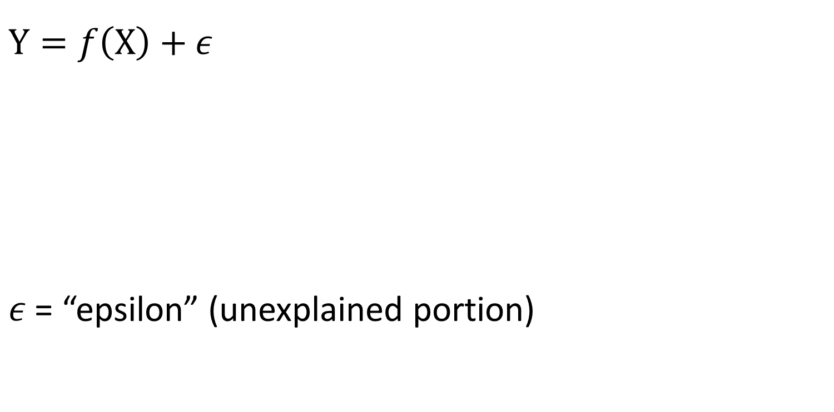
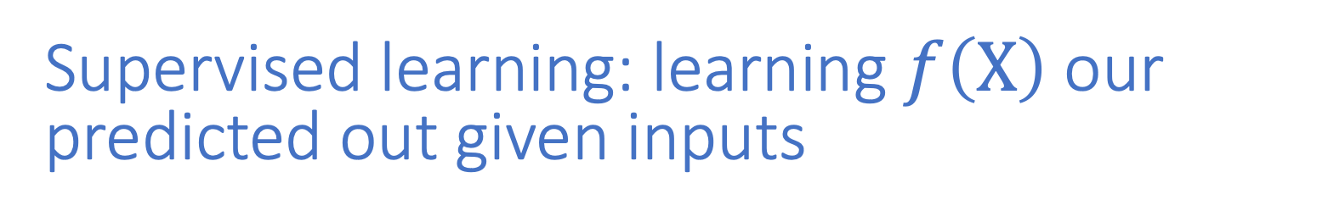
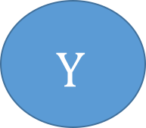
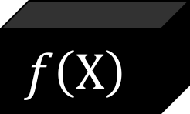

Supervised learning: learning $f\left(X\right)$ our predicted out given inputs
$$Y=f\left(X\right)+ε$$
$ε$ = “epsilon” (unexplained portion)
$$X$$
$$f\left(X\right)$$
$$Y$$

Slide 24
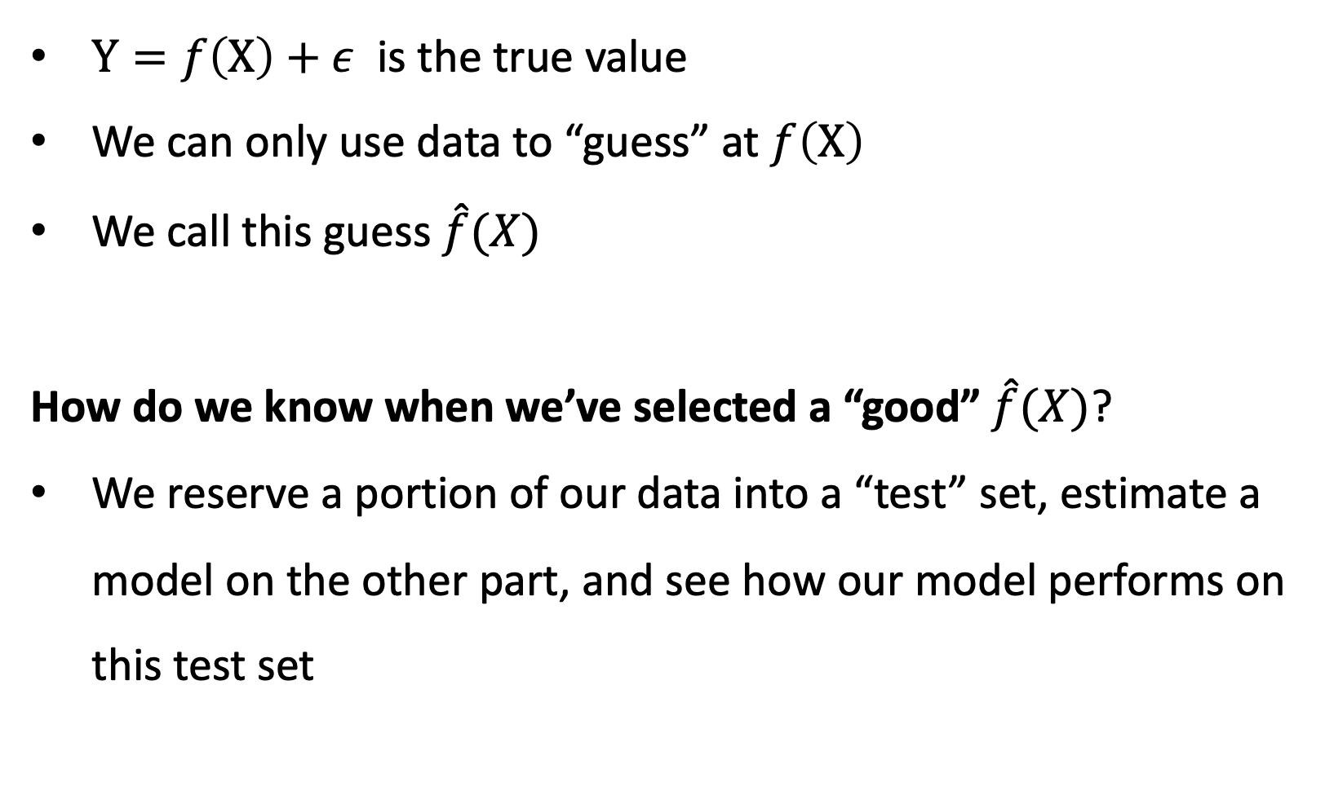
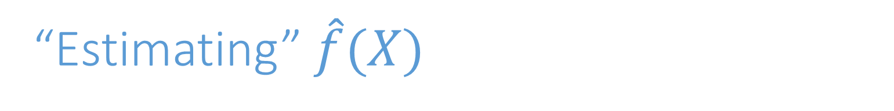
“Estimating” $\hat{f}(X)$
$Y=f\left(X\right)+ε$ is the true value
We can only use data to “guess” at $f\left(X\right)$
We call this guess $\hat{f}(X)$
How do we know when we’ve selected a “good” $\hat{f}(X)$?
We reserve a portion of our data into a “test” set, estimate a model on the other part, and see how our model performs on this test set

Slide 25
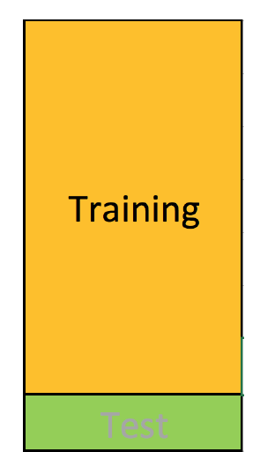
Testing Training Data Subsets
Training set: (observation-wise) subset of data used to develop models

Slide 26
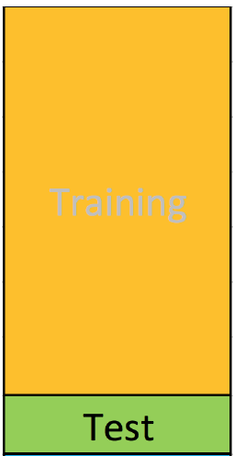
Testing/Training Split
Training set: (observation-wise) subset of data used to develop models
Test or Validation set: subset of data used during intermediate stages to “tune” model parameters
Rule of thumb 75% training 25% test -ish

Slide 27
Randomly Selecting Rows for Test or Training Sets
Observations are randomly selected into either testing or training splits of the data

Slide 28
Bias and Variance
Bias: Tendency of an in-sample statistic to over or under estimate the statistic in the population
Variance: Tendency to noisily estimate a statistic. E.g., sensitivity to small fluctuations in the training dataset.

Slide 29
Bias-Variance Tradeoff

Slide 30
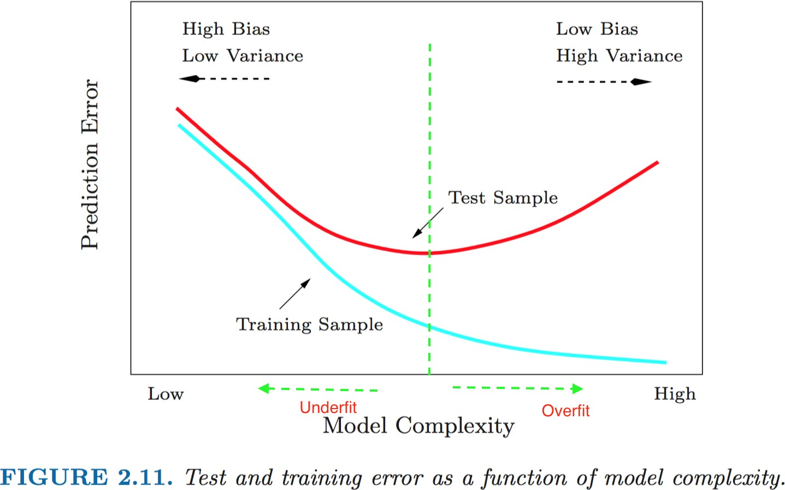
Bias-Variance Tradeoff
Error in Training sample (~bias) ↓ as we ↑ model complexity (e.g. number of variables)
Error in Test sample (~variance) ↑ as we ↑
Key: finding optimal model complexity

Slide 31
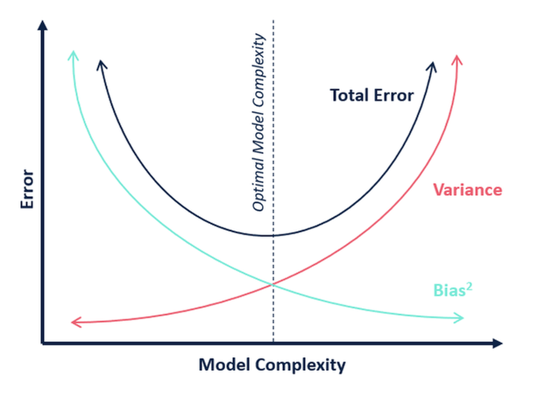
Key: Finding Optimal Model Complexity

Slide 32
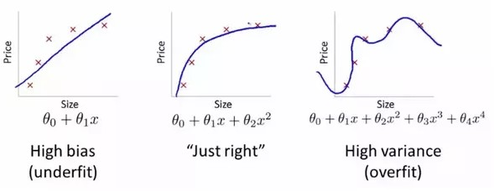
Optimal Model Complexity: Neither Underfit Nor Overfit

Slide 33
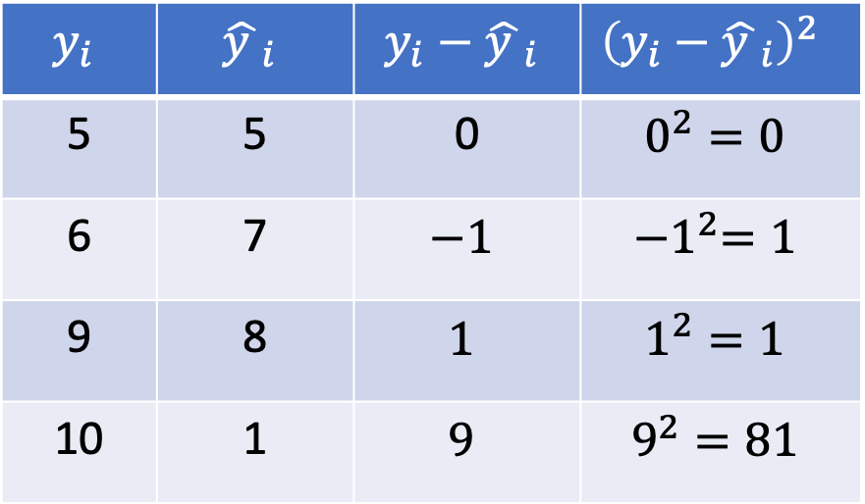
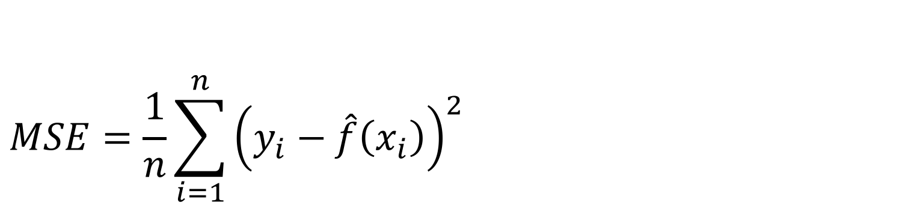
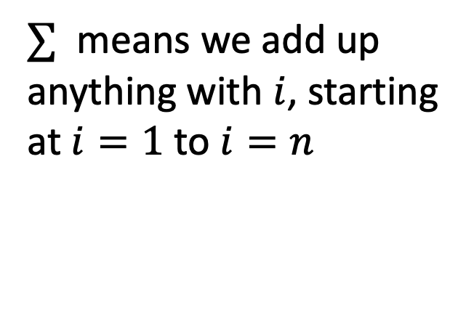
Assessing Model Accuracy: Mean Squared Error
$$MSE=\frac{1}{n}\sum_{i=1}^{n}{{\left(y_{i}−\hat{f}\left(x_{i}\right)\right)}^{2} }$$
$$y_{i}$$ | $${\hat{y }}_{i}$$ | $$y_{i}−{\hat{y }}_{i}$$ | $${\left(y_{i}−{\hat{y }}_{i}\right)}^{2}$$
5 | 5 | 0 | $$0^{2}=0$$
6 | 7 | $$−1$$ | $${−1}^{2}=1$$
9 | 8 | $$1$$ | $$1^{2}=1$$
10 | 1 | $$9$$ | $$9^{2}=81$$
$∑$ means we add up anything with $i$, starting at $i=1$ to $i=n$

Slide 34
Summary – Intro to Machine Learning
Machine Learning is a set of methods developed to find robust patterns across datasets
Public Policy can benefit from machine learning.
Big data requires it
Non-linear relationships
Better forecasts/econometrics
Anomaly detection
Remember these key concepts
Supervised (Y,X) vs Unsupervised learning (just X)
Testing/Training Sets
(model -> train, see how it performs on test)
Bias-Variance Tradeoff
Bias – how far off model from true
Variance – precision of estimated model
Total error = bias^2 + variance

